Slide 1










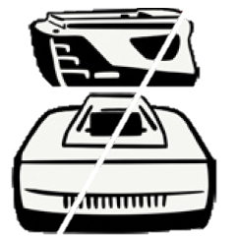

Tool Pick Up Instructions for After Sales Service
In order to avoid the disposal of your non-tool items and reduce the risk exposure to the repair experts servicing your tool, kindly follow the instructions below in sending your tools for repair
Send tools only
Attach repair paperwork, consignment or email confirmation to carton, tool case or tool
Remove heavy items from tool case, chisel and drill bits from combi / breaker
Remove any cutting blades from tools
Remove vacuum Buckets. Place head in thick plastic bag or taped box
Remove Consumables i.e. nails, cartridges & Gas Cans (dangerous item, will be disposed of)
Remove Batteries & chargers
Drain fuel from Petrol quick-off saws and remove blade
www.hilti.com.au

